Slide 1
Face-Mask Detection
Ali mahfood _ 22/2/2023

Slide 2
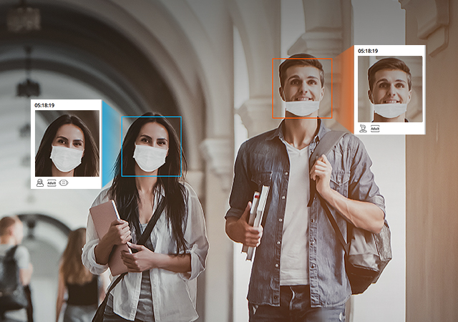
Outlines
Introduction
Dataset
Model
Evaluation Model
Demo

Slide 3
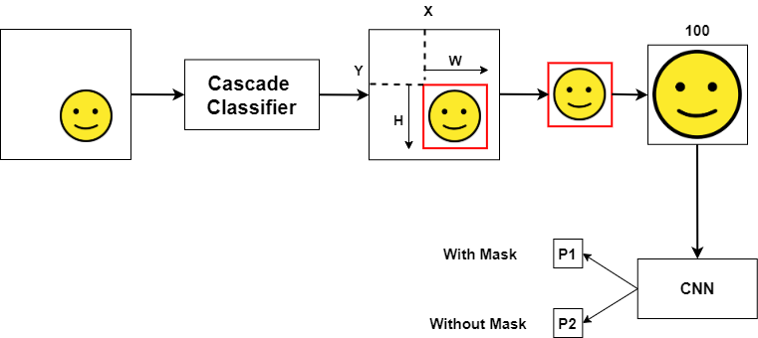
Introduction

Slide 4
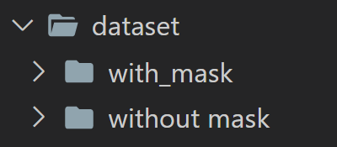
Dataset
The dataset includes two folders: with_mask, without_mask.
The with_mask folder includes about 5496 images of faces of people with mask, of a size of 200 MB.
The without_mask folder includes about 6086 images of faces of people without mask, of a size of 150 MB.
Dataset is collected from github.
Two parts of dataset composed of faces of people from different parts of the world, different ages and different positions.

Slide 5
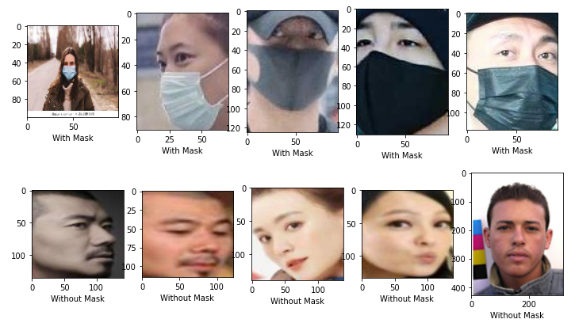
Dataset
Split dataset to 80% for training and 20% for testing

Slide 6
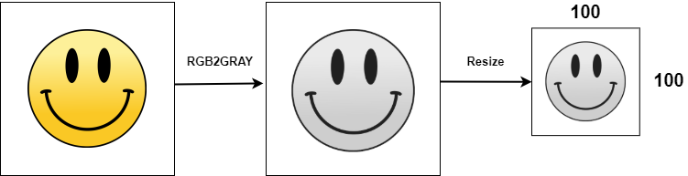
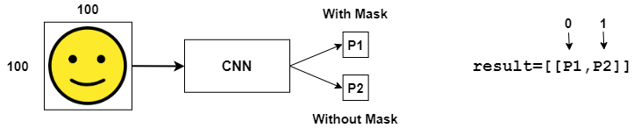
Model

Slide 7
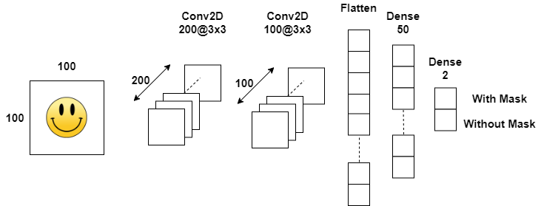
Model

Slide 8
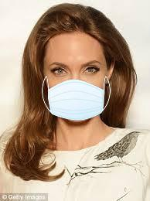
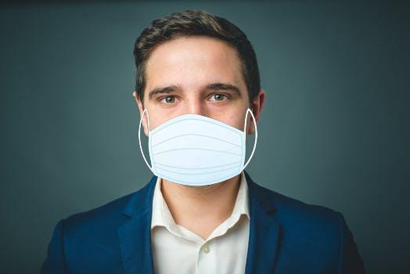
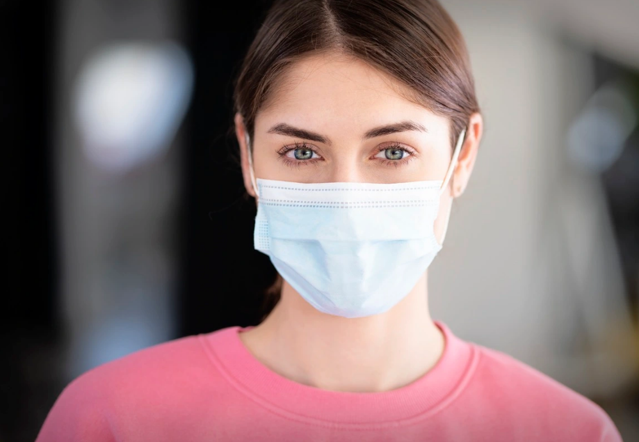
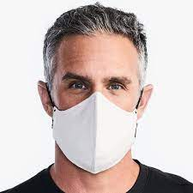


Evaluation Model

Slide 9
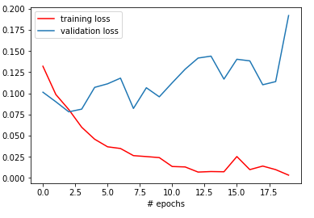
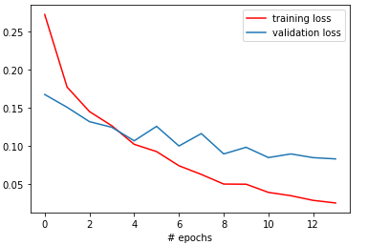
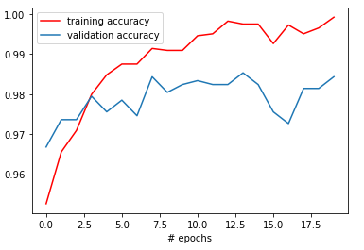
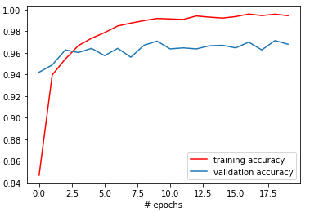
Evaluation Model

Slide 10
DEMO ..

